Slide 1
COMP407 Selected Topics II – IT Solutions for Business Final Report 2014/15 1st semester
SugarCRM Improvement System
Team members: Athena HOI Ka Wai (P1104463)
Sandy CHEN Wan Ping (P1107936) KeyLIANG Yi Juan (P1107923)
Supervisor: Dr. Benjiman Ng
Assessor: Dr. Rita Tse

Slide 2
Introduction
Overview of LTGame
The quantity of business transactions and corresponding interactions with customers become larger.
The general aim of this project is to provide an enhanced CRM system to LTGame Company to replace SugarCRM.
Notes:
Consequently, a customer relationship management (CRM) system is of the greatest necessity and importance for the company. To meet their needs, SugarCRM is tried to be used in the company. However, some problems still occurs.

Slide 3
Introduction
Objectives
Get the information of the company and identify the problems in their IT system.
Identify the requirement of the IT system.
Proposed an enhanced CRM system that satisfies the requirements.
Make the utilization of the system in the staffs reach 90%.

Slide 4
Background
Live Multiple Games System
Paradise Jackpot System
LTGame there are many kinds of issues in marketing, sales, customer service and technical service.
SugarCRM is a customer relationship management (CRM) system that is available in both open-source and commercial open-source applications.
Flexible management system and perfect IT equipment management function, which makes the process of managing customer relationships systematically.
Notes:
The Live Multiple Games machines include Live Baccarat, Live Roulette, Live Sicbo, Live Blackjack, Live SanGong and Live Keno.
The Paradise Jackpot is a patent granted Baccarat-based progressive jackpot.
For example, there are lots of after-sale services in the LT Game, CRM system could track every service until it solved.
SugarCRM systemcan enhance the competitiveness of the enterprise and service quality.

Slide 5
Methodology
REQUIREMENT ELICITATION
Know more about the SugarCRM
Discover current issues
Gather requirement
Our solution
Observe user behaviors
Be one of the user
Discover issues from experiment

Slide 6
REQUIREMENT ELICITATION
Observation
Operation of different position
Project Manager
IT Manager
Technician
etc.
Scenario of operating
Initial new case
Operation
Activity

Slide 7
REQUIREMENT ELICITATION
Problems Identification
Search engine
Interface
Import/export
Create a client server
Report function

Slide 8
Requirement Specification
Functional requirements
User Registration
Case Operation
Staffs of Casinos directly import the case into the CRM system
Searching case information
NON-Functional requirements
Providing two languages which are Chinese and English.
Users of CRM system shall be IT supporter or floor manager
A training course shall be provided

Slide 9
Requirement Specification
Domain requirements
The CRM should be able run on windows os and mac os which are the most common personal computer platform.
This CRM system only provides online services.

Slide 10
System Implementation
Platforms
The PhpStorm would be used as the main development tool.
The server side, Apache will be used, and MySQL would be used as database side.

Slide 11
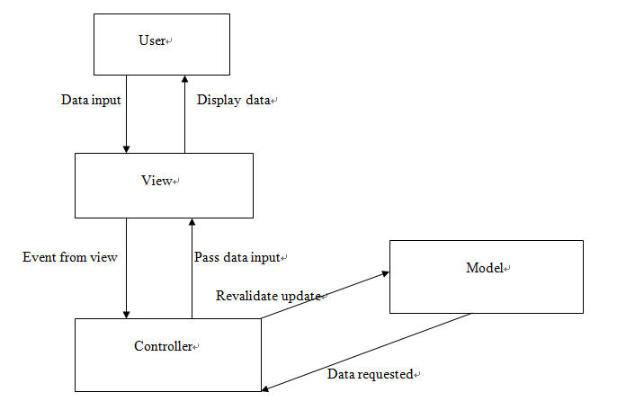
System Implementation
Architecture
The client-server web application follows MVC software design pattern.

Slide 12
System Implementation
Data Modeling - Identifying entity type
The following table shows the specific attributes of the classes in the function.
Entity name | Attributes | Description | Data type &length | Nulls | Multi-valued
Staff | Email | Uniquely identity email of staff in casinos | 30 variable characters | No | No
 | Name | The name of staff | 15 variable characters | No | No
 | Company | The company of the staff | 50 variable characters | No | No
 | Password | Password for user verification | 6-16 characters and both number and character are required | No | No
Case | Subject | The subject of the post | 30 variable characters | No | No
 | description | The description of the post | 200 variable characters | No | No
 | PostDate | The date the staff that post the problem | Date | No | No
 | status | The problem of posts’ status | 15 variable characters | No | No
Technician | Email | Uniquely identity email of operator | 30 variable characters
 | Name | The name of operator | 15 variable characters
 | Password | Password for operator verification | 6-16 characters and both number and character are required | No | No

Slide 13
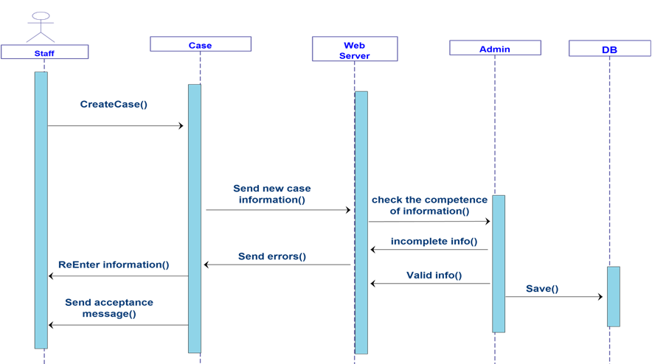
System Implementation
Data Modeling - sequence diagram
The following is the sequence diagram of staff in casinos creating a new case.

Slide 14
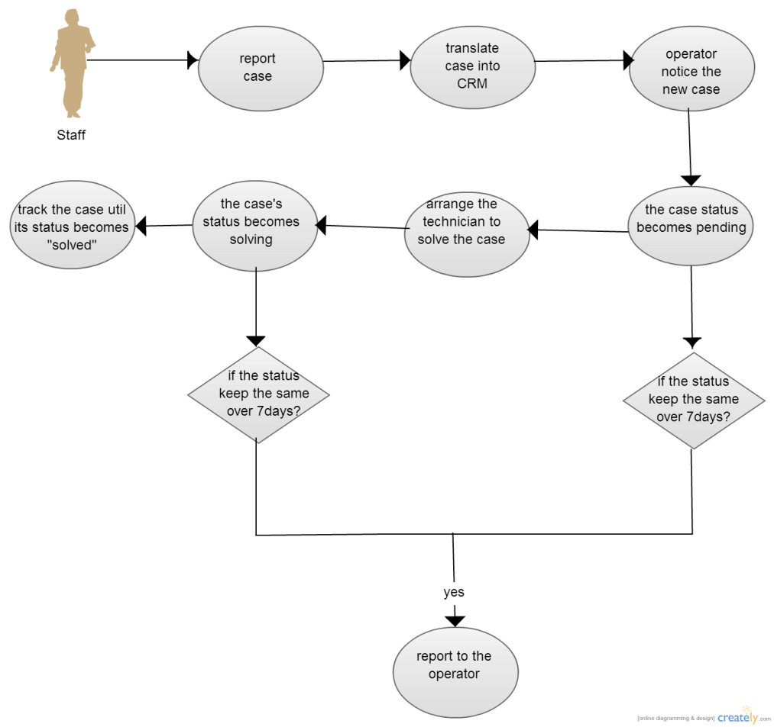
System Implementation
Data Modeling – create a new case
The following is flow chart which shows the progress of the function of creating new case.

Slide 15
System Implementation
Enhancement to existing system
Problem reports can be type in a text box instead of using the SugarCRM or Excel file.
Once a problem is reported, E-mail will be also sent to IT manager.
The system server will check reported cases every day.
Notes:
This reduce the complex process of doing a report from the staff to the CRM system because what the staff need to do is type the same simple description into this application and send it out.
If an case is reported over 10 days but not yet closed, a warning e-mail will be sent to the managers and technicians who are related to the case.

Slide 16
System Implementation
Key problems and their solutions
The project met problem in installing into the system of LTGame.
Promoting this new CRM to casino manager and IT technician as they are unwilling to learn a new system.
A lot of managers are unwilling to spend time to have an extra training.
Notes:
The importance of using a new CRM is explained to them so that they would attend the training section and learn how to use it effectively.

Slide 17
Results and discussion
PROJECT OUTCOME
Casino floor manager :
Report new cases
Check the status of the cases they create
Confirm the complete of the
LTGame Operator:
Update the status of case
Create new account
View all the created accounts in group of casinos.
View all the reported cases
Change case status
Search case
Sort search results by case name, status, subject, people to assign, account name, priority

Slide 18
conclusion
We have studied the main function of existing Sugar CRM in the LTGame company.
We have done the requirement analysis of CRM system.
Design a new proposed CRM to improve the original one.

Slide 19
Q&A Thanks for your listening!

